Slide 1

FOOD DELIVERY APPLICATION
Under Guidance Of
POOJA MEHTA SUBMITTED BY
1. ABISHEK
2. ANUSUYA
3. DEVADHARSHINI
4. JAYASHEELA
5. KIRUTHIKA
6. SHRIVARSHINI
7. SWATHI

Slide 2
INTRODUCTION
Online food ordering is the process of ordering food, for delivery from a website or other application. The product can be either ready-to-eat food despite the lack of personal interaction, the software provides online customers with the same features someone visiting the restaurant or ordering on the phone would have this includes access to the entire menu with full customization.

Slide 3
PROJECT OBJECTIVE
To evaluate the way of interaction with customers.
To develop a restaurant ordering system with web application based on the client server application.
To determine the factors that influence customer when ordering food online.

Slide 4
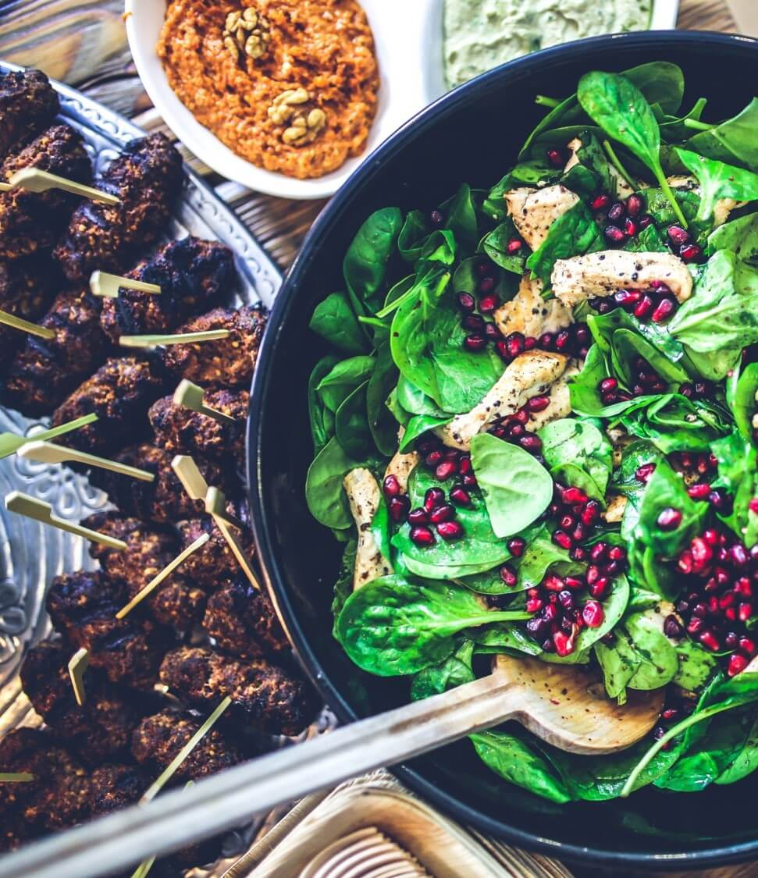
TECHNOLOGIES USED
Spring Boot
MySQL
Postman
Angular

Slide 5

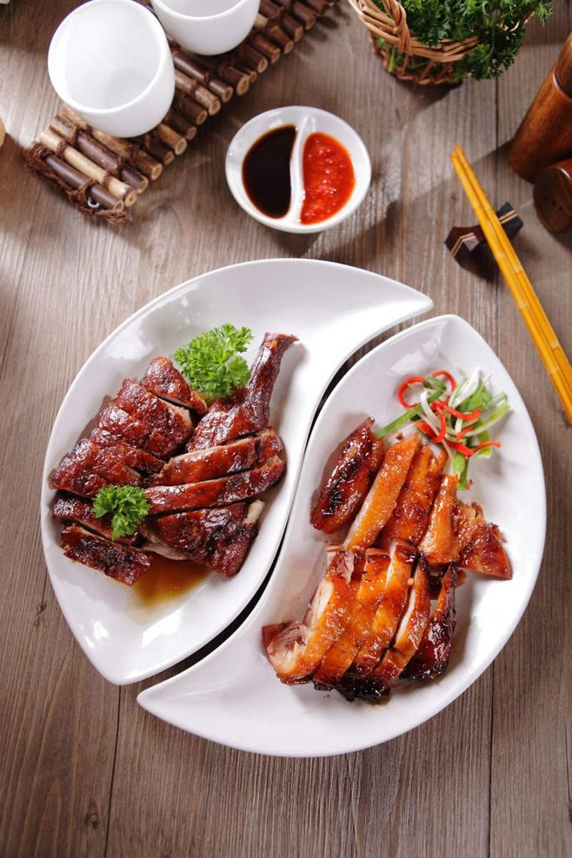
REQUIRED SPECIFICATIONS
Hardware Configuration
Software Configuration
Software IDE: Spring Tool Suite
Language: Java
Front End: Angular
Back End: MySQL ,Postman
Operating System: Windows 10
Hard Disk: 1 TB
RAM: 4GB

Slide 6
PROPOSED SYSTEM
This system is a bunch of benefits from various point of views. As this online application enables the end users to register to the system online,
Select the food items of their choice from the menu list,then order food online And also we are able to add, update and delete food items in cart.
System will store the information about new entry of food item, maintain quantity record. It will keep the record of the customer.

Slide 7
SPRING ANNOTATIONS
@Controller :The @Controller annotation indicates that a particular class serves the role of a controller. Spring Controller annotation is typically used in combination with annotated handler methods based on the @RequestMapping annotation.
@Autowired: The @Autowired annotation provides more fine-grained control over where and how autowiring should be accomplished.
@RequestMapping : @RequestMapping is one of the most common annotation used in Spring Web applications. This annotation maps HTTP requests to handler methods of MVC and REST controllers.
@Entity:The Entity annotation specifies that the class is an entity and is mapped to a database table.

Slide 8
SPRING ANNOTATIONS
@Table: The Table annotation is used to create a table in database.
@JoinColumn: @JoinColumn is used to specify a column for joining an entity association or element collection.
@PutMapping :@PutMapping is used for update the records.
@PostMapping: @PostMapping is used to create a resource Mapping.
@GetMapping: @GetMapping is used to read all the inserted records.
@DeleteMapping : @DeleteMapping is used to delete the records.
@PathVariable: The Path Variable annotation is used to extract the value from the URL.
@RequestParam: @RequestParam annotation is used to read the form data and bind it automatically to the parameter present in the provided method.

Slide 9
SPRING ANNOTATIONS
@Request Body: The @RequestBody annotation is applicable to handler methods of spring controller. spring should deserialize a request body into an object.
@OneToOne Mapping: The @OneToOne JPA annotation is used to map the source entity with the target entity, Hibernate maps the tables in your database to the Entity classes in your application.
@OneToMany Mapping:OneTo-Many relationship between table A and table B indicates that one row in a table A link to many rows in table B.but one row in table B links to only one row in table A.
@ ManyToOne Mapping: @Many-to-One mapping means that many instances of this entity are mapped to one instance of another entity.

Slide 10
SPRING VALIDATION
@ExceptionHandler:The @ExceptionHandler is an annotation used to handle the specific exceptions and sending the custom responses to the client.
@ControllerAdvice: A controller advice allows you to use exactly the same exception handling techniques but apply them across the whole application, not just to an individual controller. You can think of them as an annotation driven interceptor.
Handles Resource Not Found Exception
Handles Method Argument Not Valid Exception
Handles Constrain Violation Exception

Slide 11
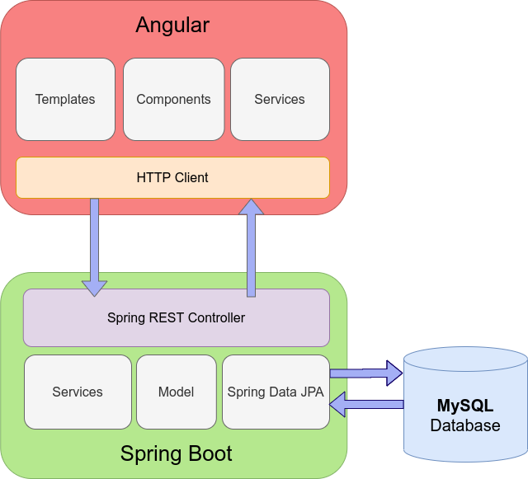
SYSTEM FLOW DIAGRAM

Slide 12
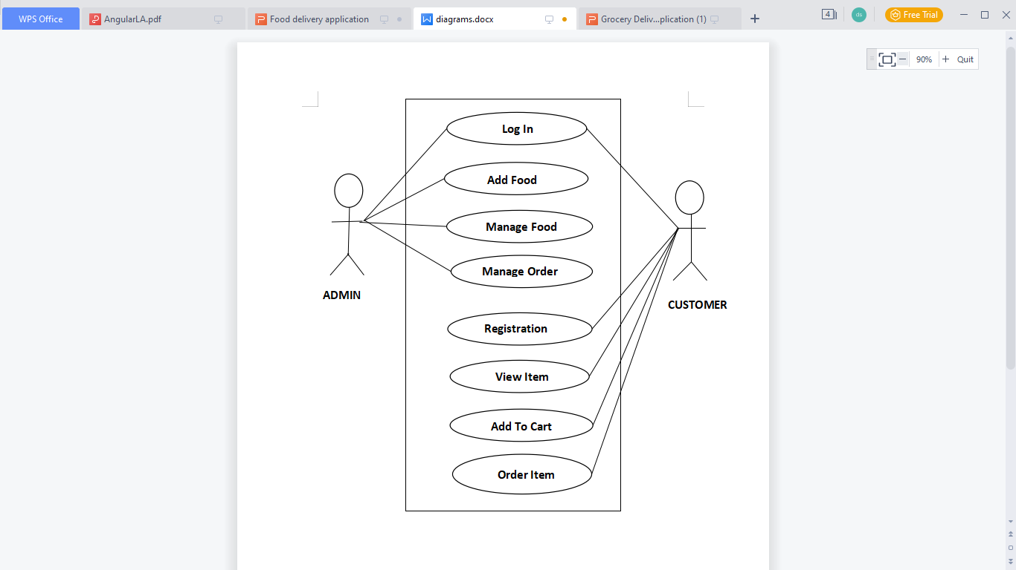
USECASE DIAGRAM

Slide 13
CLASS DIAGRAM
Prodct
+ menu_id: int
+food_category:string
+ food_quantity: int
+food_MRP:int
+add_food()
+edit_food()
ADMIN
+id: int
+ name: string
+ username: string
+ password: string
+create()
+update()
Order
+id: int
+details: int
+ordertype: string
+processDebit()
Customer
+name:string
+Email id:string
+password:String
+address: string
#cardnum: int
+placeOrder()

Slide 14
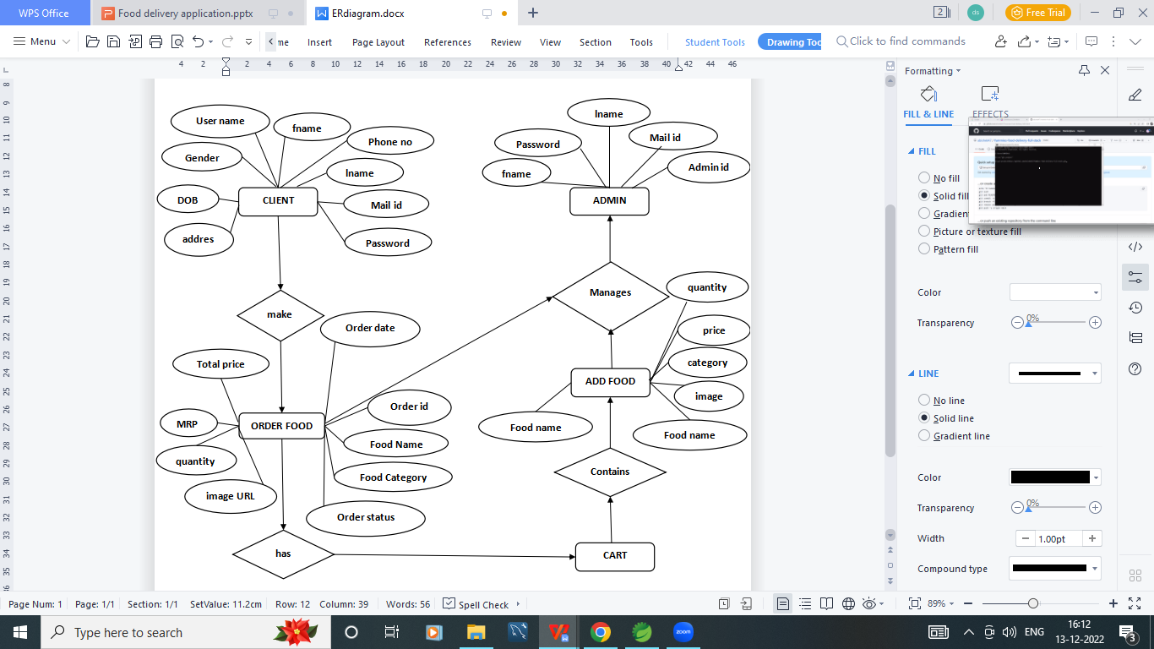
ER DIAGRAM

Slide 15
MODULES
The system contains 5 Modules
ADMIN - Registration and Login.
CLIENT - Signup and Login.
MENU LIST - Add/Edit Food items by Admin.
CART - Customer can add food from menu list
ORDER - It shows items which present in cart and order status.

Slide 16
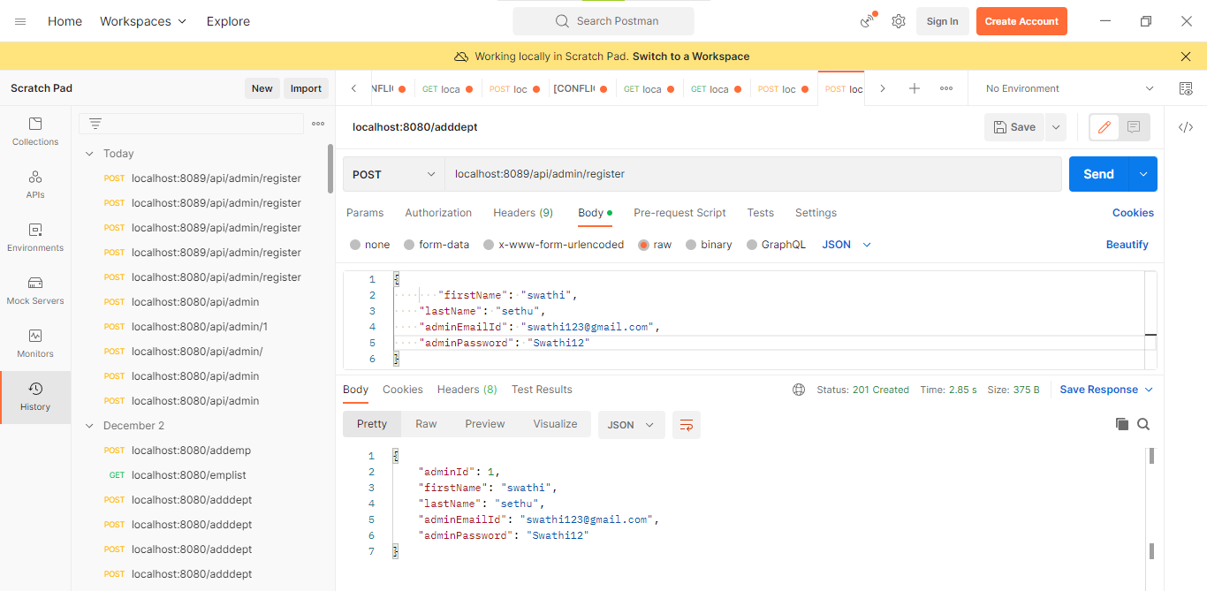
OUTPUT SCREENSHOTS ADMIN REGISTRATION IN POSTMAN

Slide 17
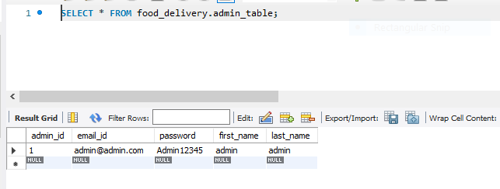
ADMIN TABLE

Slide 18
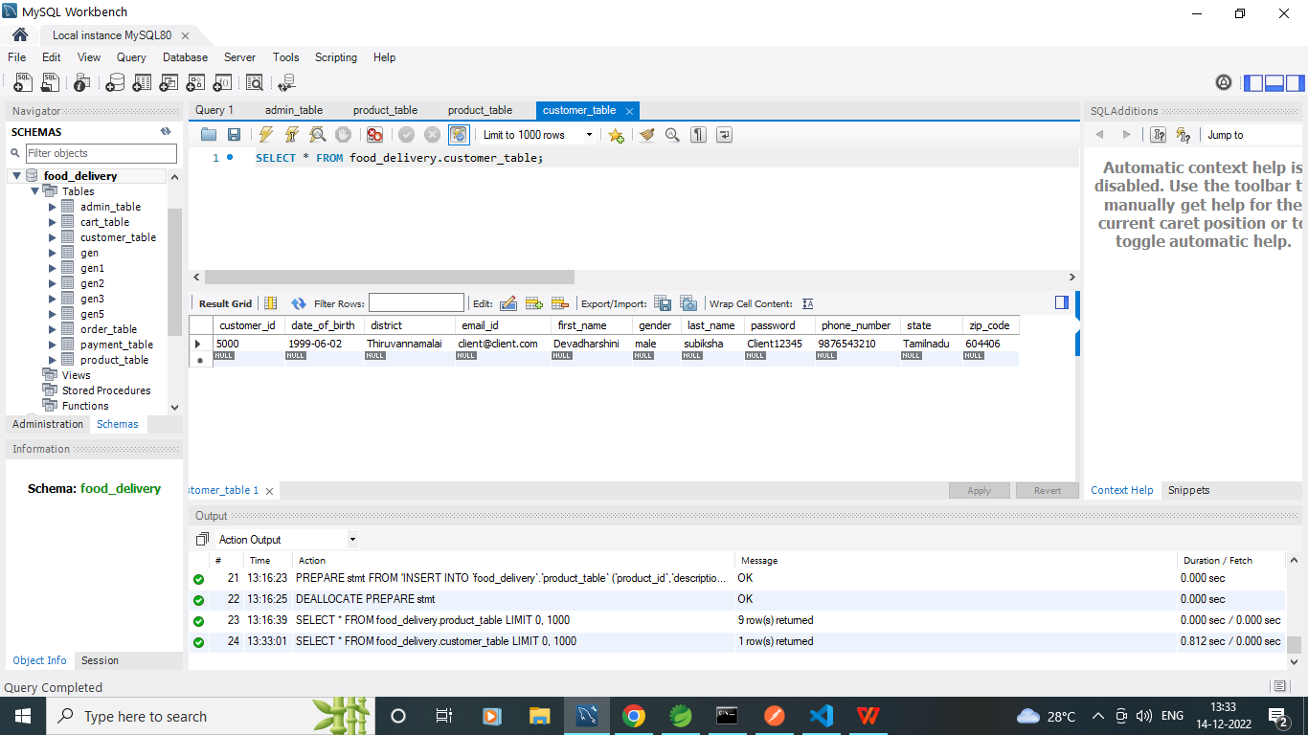
CUSTOMER TABLE

Slide 19
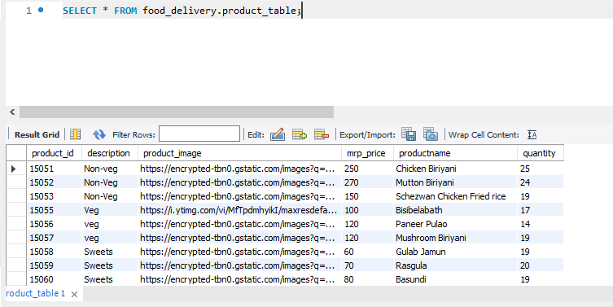
PRODUCT TABLE

Slide 20
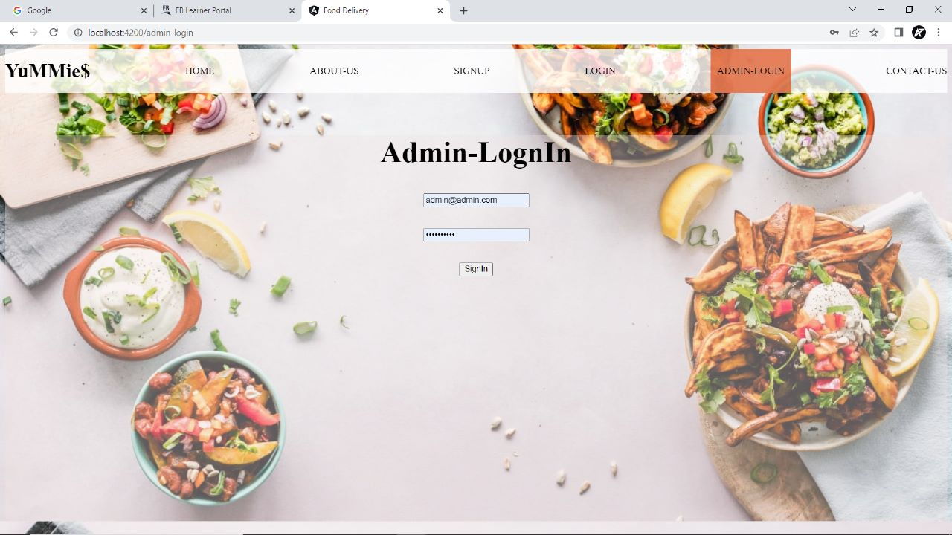
ADMIN MODULE

Slide 21
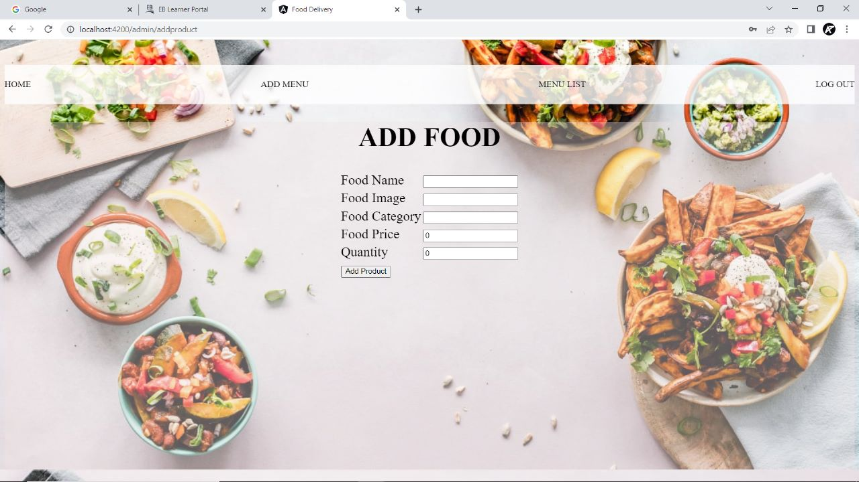
ADMIN MODULE

Slide 22
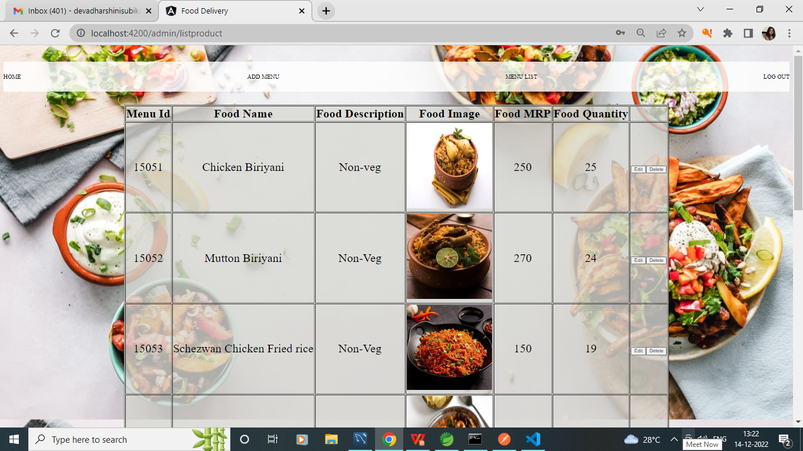
ADMIN MODULE-MENU LIST

Slide 23
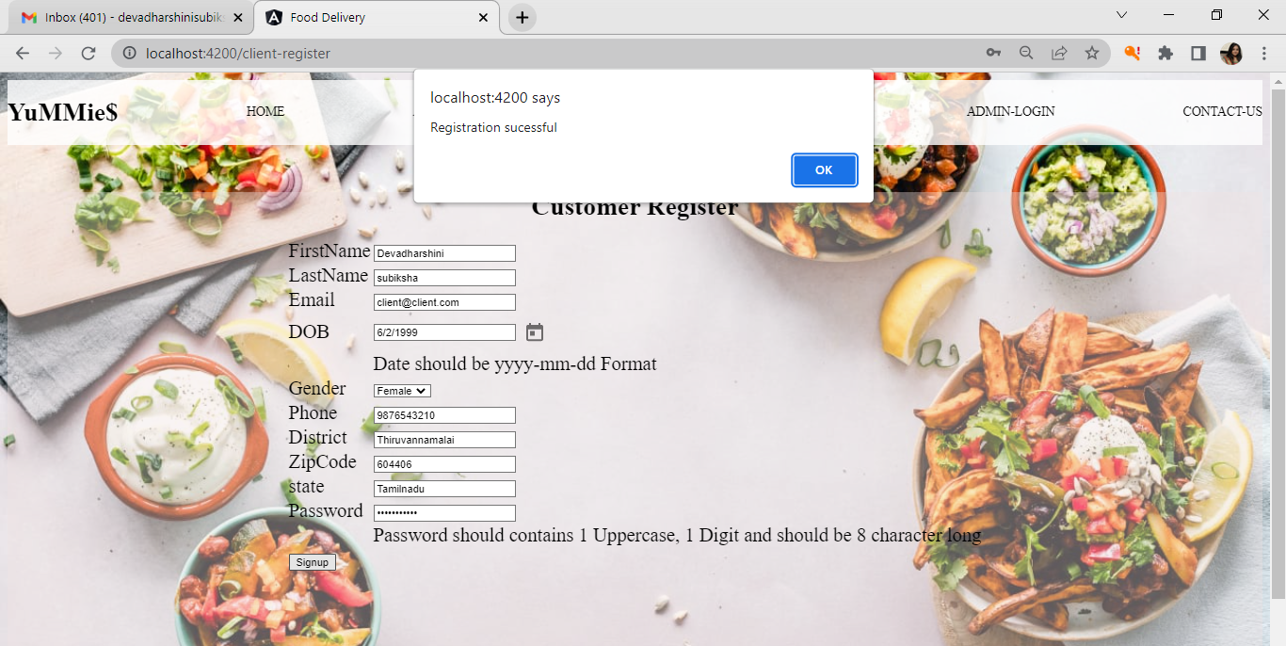
CUSTOMER MODULE

Slide 24
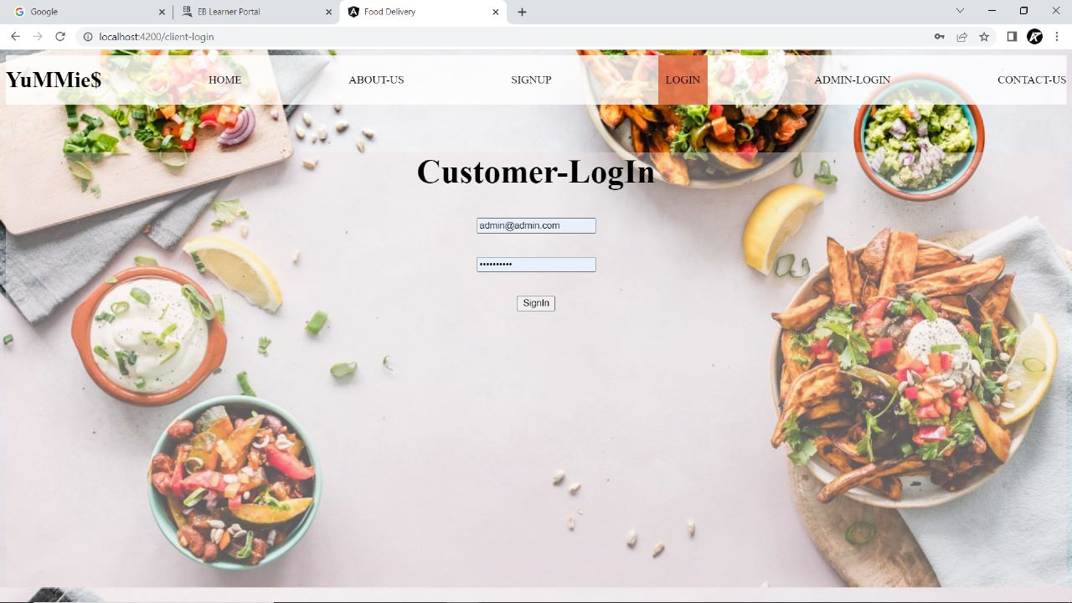
CUSTOMER MODULE

Slide 25
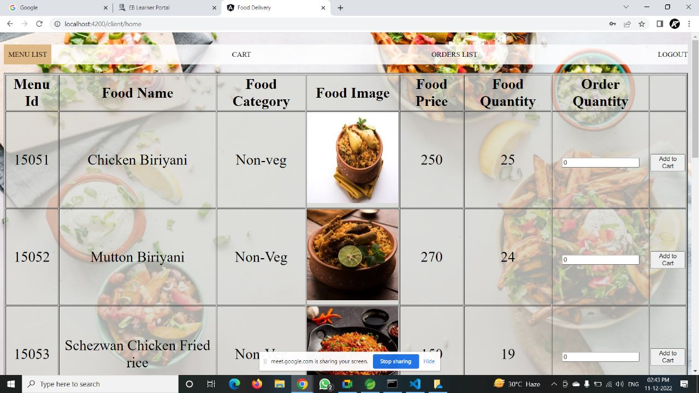
CUSTOMER MODULE

Slide 26
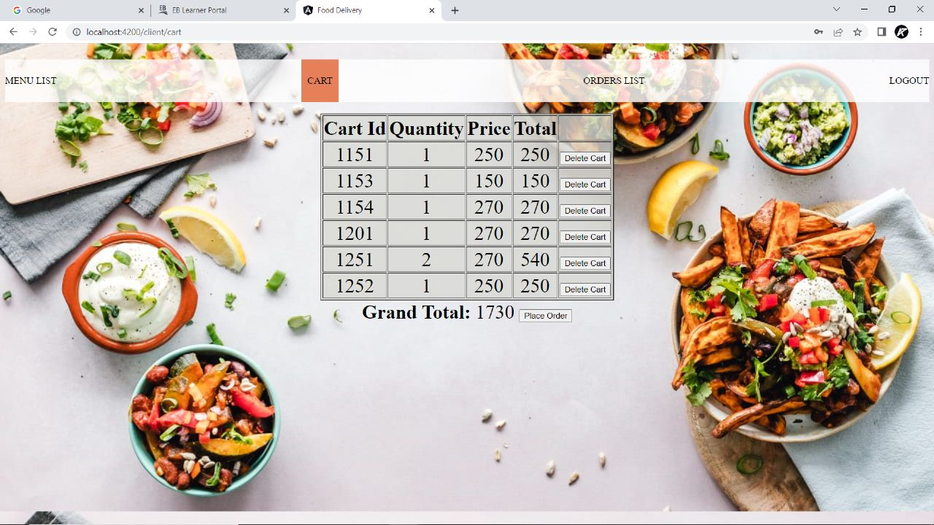
CART

Slide 27
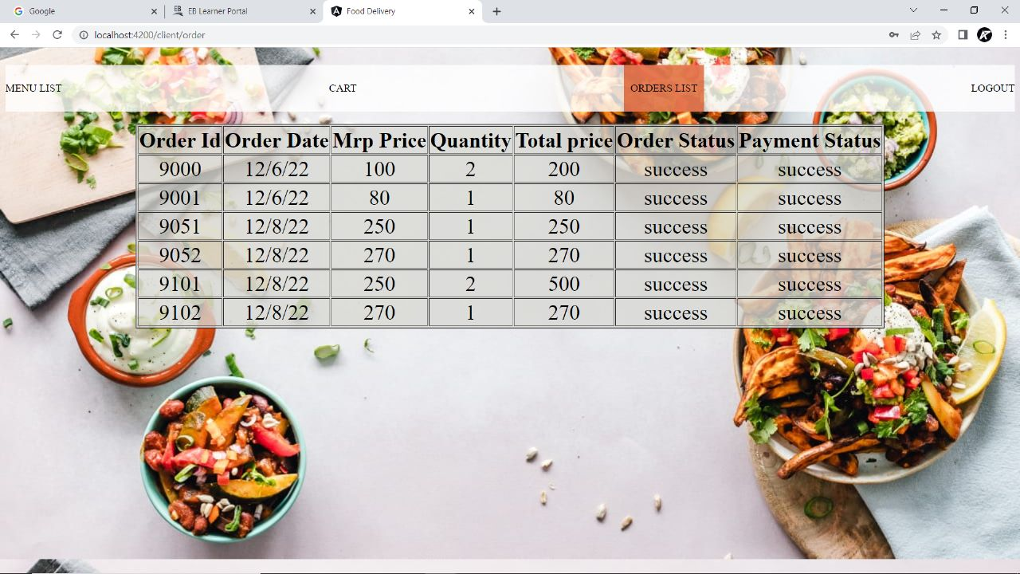
ORDERS LIST

Slide 28
ADVANTAGES
Clients can order whenever they want..
Makes the ordering process easier.
Customer's satisfaction.
The convenience of mobile ordering
No more waiting in long queues to place an order.
Discover New Items.

Slide 29
CONCLUSION
Online Food Ordering system is done to help and solve one of the important problems of customer. Because Large number of customer can use the internet and phone. Various issues related to Mess Tiffin Service will be solved by these system .Thus, implementation of Online Food Ordering system is done to help and solve one of the important problems of customer. It helps customer in making order easily and gives information needed in making order to customer place.

Slide 30
THANK YOU

